Slide 1
CUSTOMER SEGMENTATION & DATA PROFILING

Slide 2
CUSTOMER DATA SUMMARY
Base on the analysis, the number of transactions for the 3 month period (August to October 218) the number of transactions range from as low as: 31 to as high as 746.
Salary payments happen on a daily basis for the different Customer groups. There are customers who receive Payment on weekdays and others on weekends.
The total transactions a month continued to increase month on MOM when we view all customers wholistically.
Average amount per transaction is $187.93

Slide 3
SPEND BY GENDER IN AUGUST 2018
The highest spend is by Males during this period, as the females tend to spend a lower amount during the period.

Slide 4
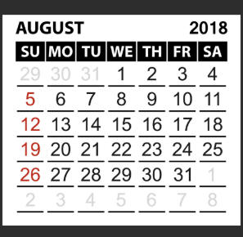
DAILY SPEND IN AUGUST 2018
CALENDAR
||Based on the analysis of the graph, there seems to be a high spend on Fridays. Indication of spending before the weekend starts, perhaps people also get into relaxation mode after a busy week working.

Slide 5
TRANSACTION VOLUME FOR AUGUST 2018
Transaction volume also tend to be high on Fridays, then they take a deep and again increase toward the end of the week.

